Slide 1

User Registration Module Testing: Final Execution Summary
Project
ParaBank User Registration Module (REG)
Testing Cycle
Manual & Exploratory Testing
Date
November, 15, 2025
Presented by
Mahmoud Sameeh

Slide 2

Project Context and Testing Scope
Category
Detail
Module
User Registration Module (REG)
Requirements
REG-001 to REG-040 (Functional, Validation, Usability)
Test Approach
Manual Testing (Positive, Negative, Boundary Value Analysis, Equivalence Partitioning)
Key Goal
Ensure the module is stable and ready for integration
✓ In-Scope Functionalities
✗ Out-of-Scope Functionalities
•
Opening the registration page and form
•
Backend database validation, API-level testing
•
Validation of all personal information fields (length, character limits, format)
•
Load/performance testing, Mobile device testing
•
Error message display for invalid/blank inputs
•
Security/Penetration testing
•
Successful end-to-end account registration flow
•
Multi-language support and Email verification workflows

Slide 3

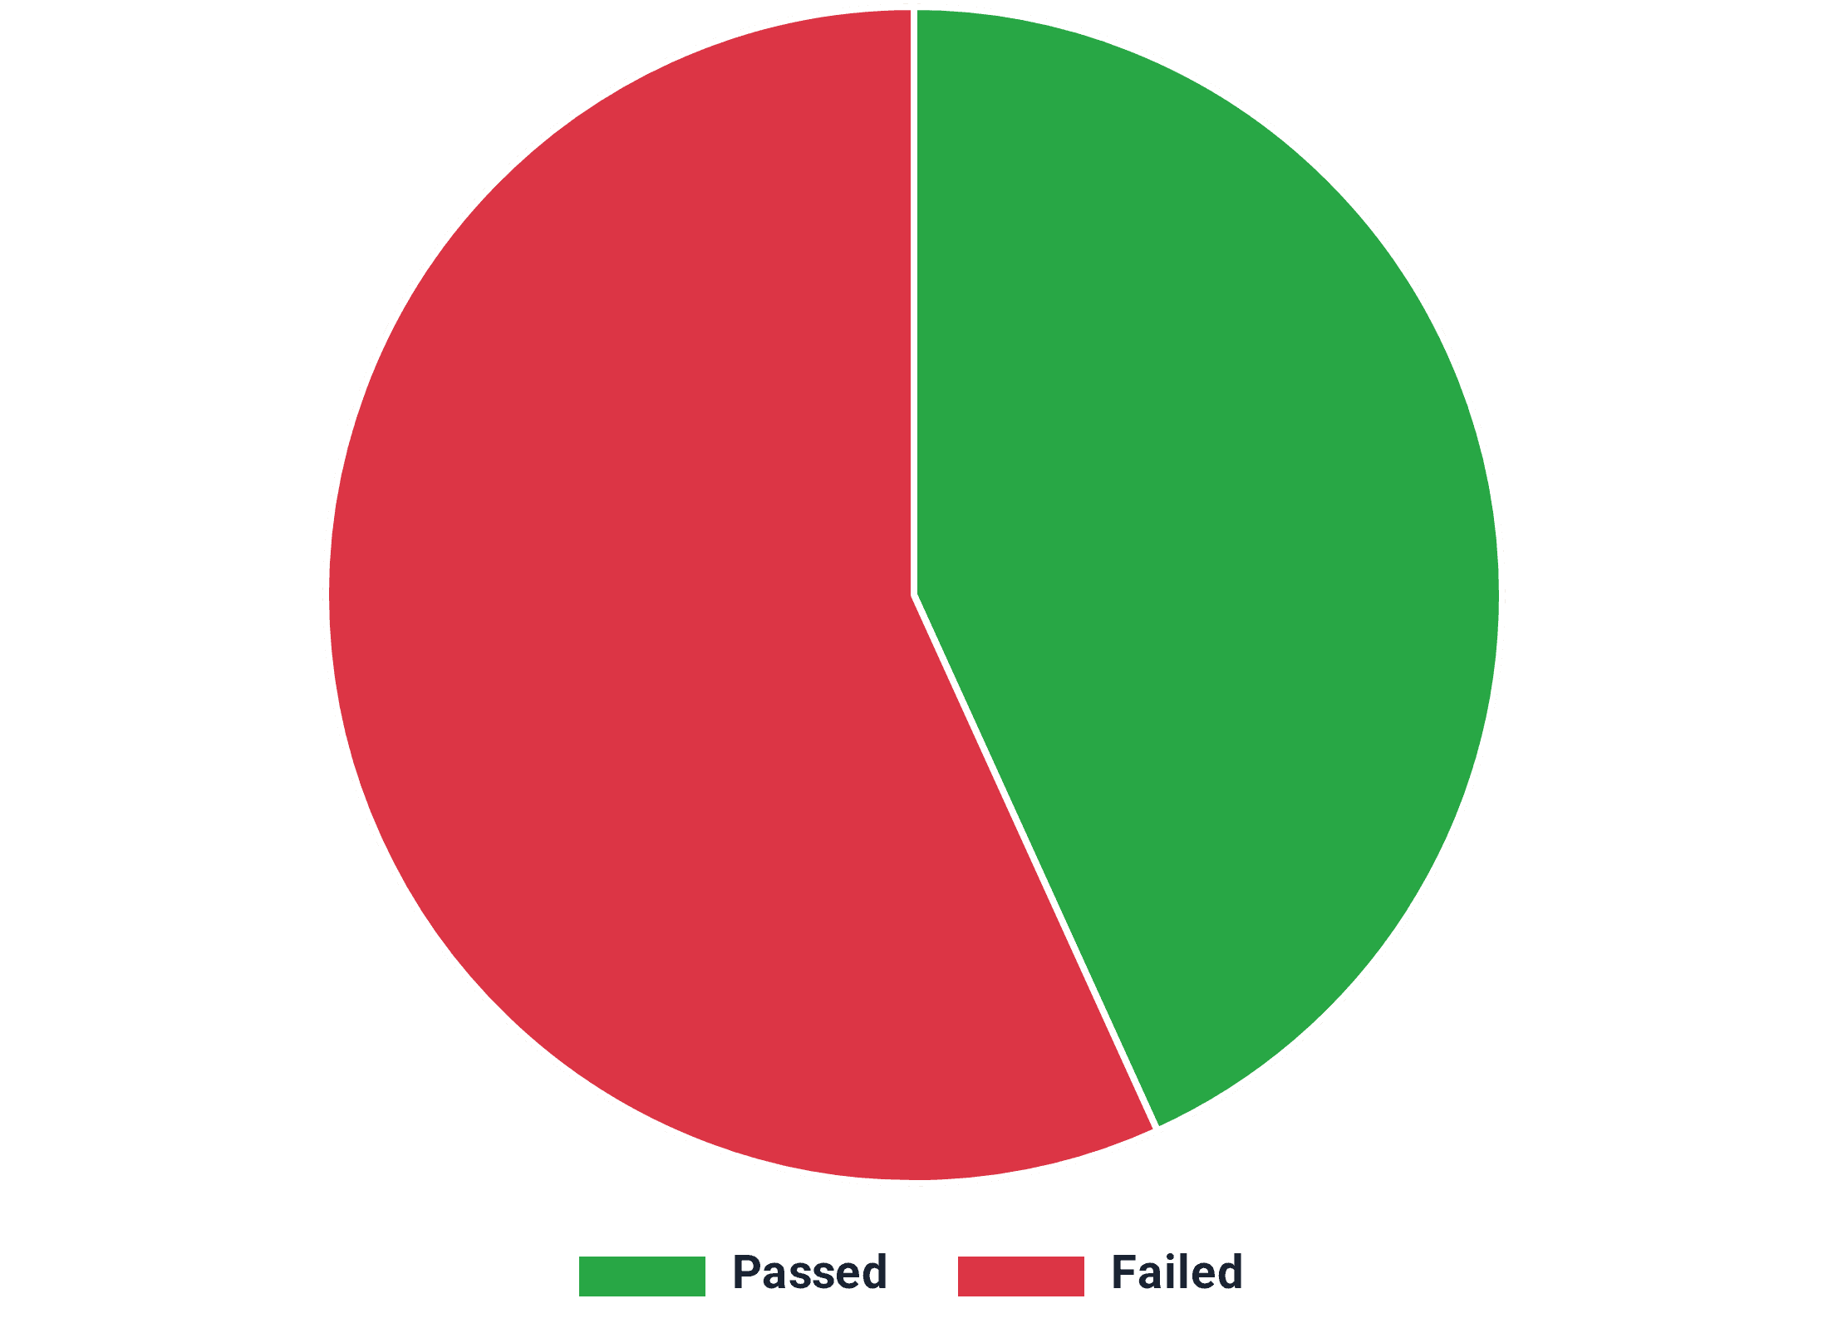
Test Execution Results: Low Pass Rate Indicates Instability
Total Test Cases
81
Passed Test Cases
35
Failed Test Cases
46
Pass Rate
43.21%
Key Finding: The Pass Rate of 43.21% is unacceptably low for a core module, confirming that the User Registration Module is NOT STABLE and requires immediate remediation before release.

Slide 4

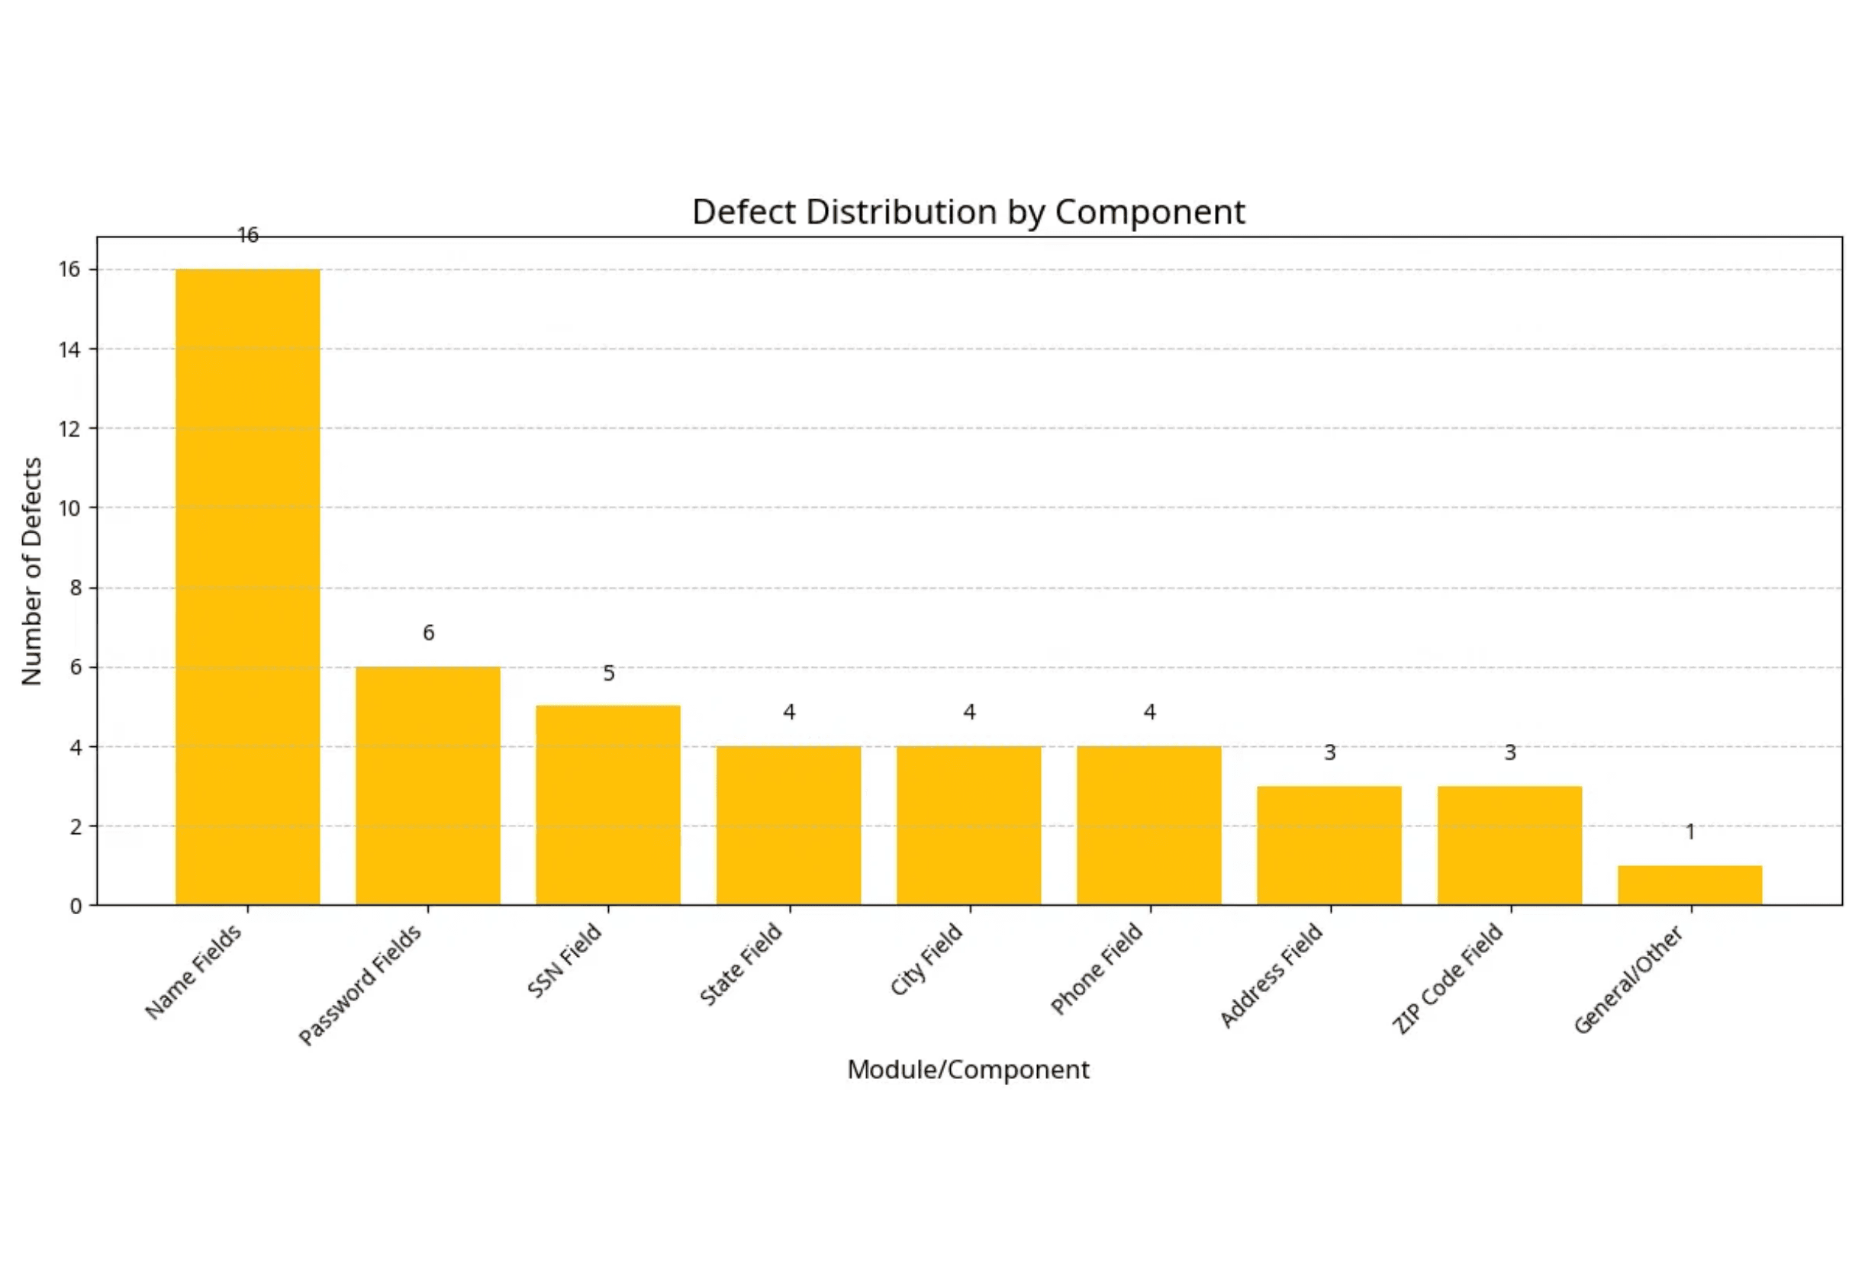
Defect Distribution by Component
Name and Password Fields are the Primary Defect Sources
Top 3 Defect Areas
1
Name Fields
16
34.8% of all defects
2
Password Fields
6
13.0% of all defects
3
SSN Field
5
10.9% of all defects
Over one-third of all defects are concentrated in the Name fields, primarily related to character validation and length constraints.

Slide 5
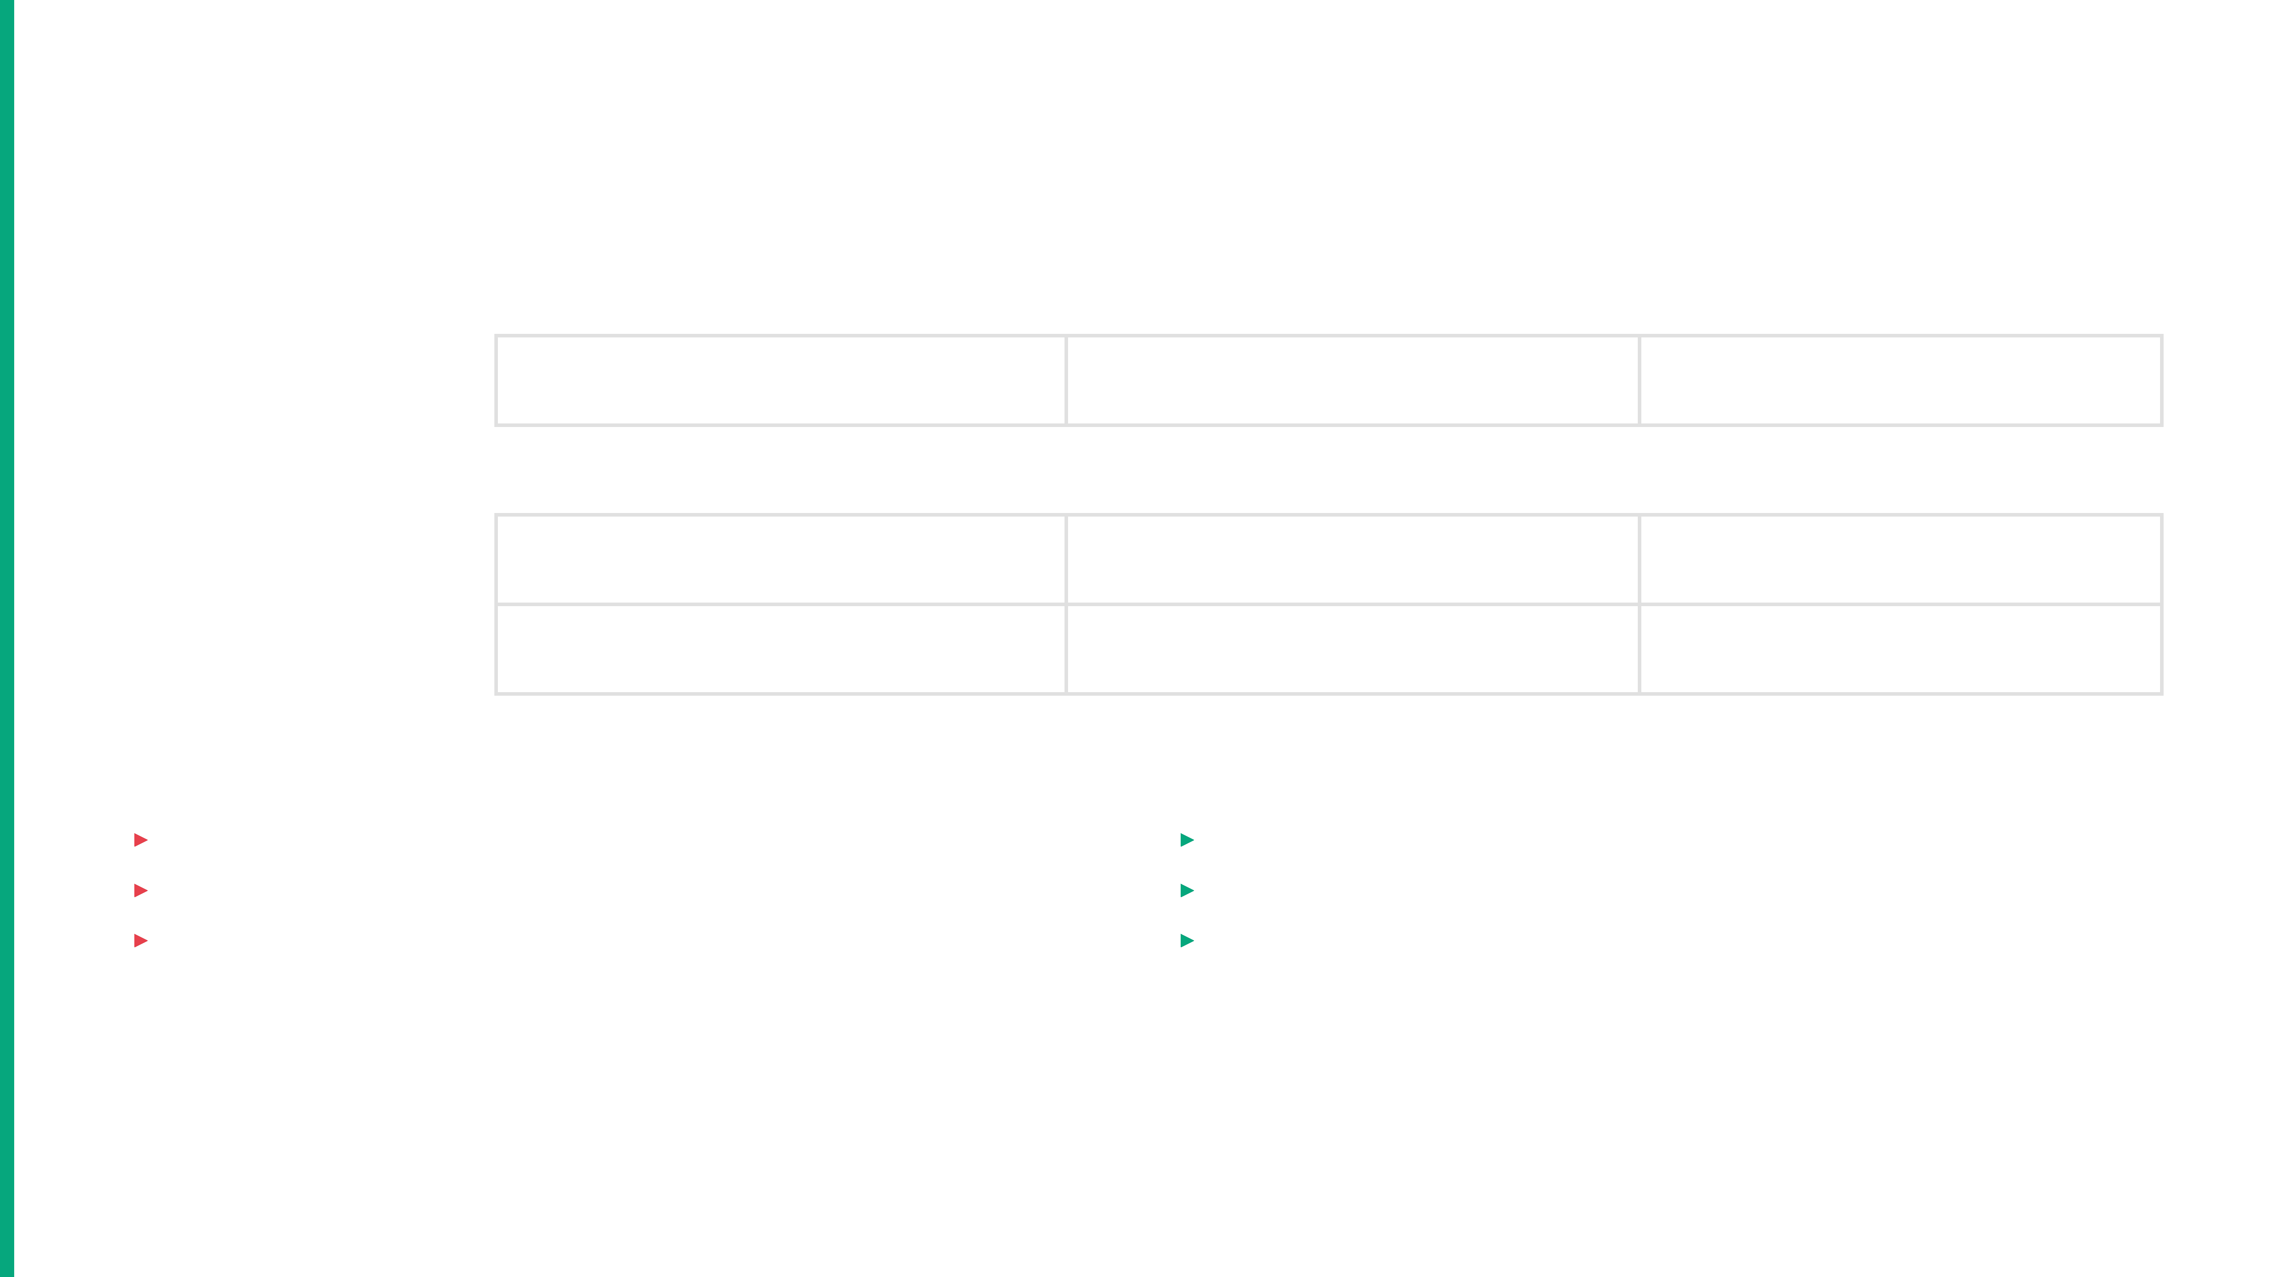
Defect Analysis: Priority and Severity
All Defects are High or Medium Priority
Priority
Major Severity
Minor Severity
Total Defects
High
2
0
2
Medium
16
28
44
Low
0
0
0
Total
18
28
46
High Priority Defects (2)
Medium Priority Defects (44)
▸
Both classified as
Major
severity
▸
16 Major
severity defects
▸
Blocking core functionality and critical paths
▸
28 Minor
severity defects
▸
Must be resolved before module integration
▸
Collectively impact overall module stability

Slide 6

Key Findings and Observations
Systemic Failure in Input Validation
1. Failure to Enforce Negative Scenarios
▸
A significant number of failed test cases (e.g., TC_Reg_03, TC_Reg_04, TC_Reg_05) incorrectly allowed registration with invalid data (numbers in name, special characters)
▸
The system displayed success message: “Your account was created successfully”. You are now logged in.' even when validation rules were violated
▸
This indicates a complete bypass of validation logic or missing server-side validation
2. Critical Validation Failures
▸
The SSN and Username validation logic is fundamentally flawed, leading to blocked test cases and High Priority defects
▸
Boundary Value Analysis (BVA) tests for minimum/maximum length constraints failed across multiple fields (Name, Address, City)
▸
These failures directly impact the module's ability to enforce business rules and data integrity
3. Inconsistent Error Handling
▸
While some mandatory field checks passed (e.g., blank First Name), the system's response to other invalid inputs was inconsistent
▸
Some validation errors were properly caught, while others allowed invalid data to proceed to registration
▸
This inconsistency suggests partial or incomplete implementation of validation rules across different fields

Slide 7

Conclusion and Q&A
1
Module is NOT READY for Release
The 43.21% pass rate and 91.3% critical/major defect concentration indicate fundamental instability requiring immediate remediation.
2
Core Validation Logic is Fundamentally Flawed
The system is accepting invalid data across multiple fields (names, addresses, passwords), posing significant security and data integrity risks.
3
High-Priority Defects Demand Immediate Action
All 41 Major and Minor defects must be resolved before proceeding with integration or release activities.
Presenter
Email
Mahmoud Sameeh
mahmodesameeh11@gmail.com

